Slide 1
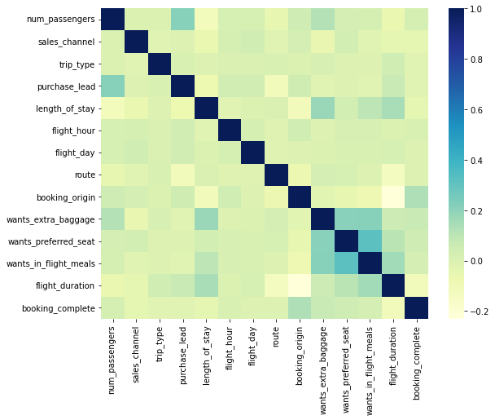
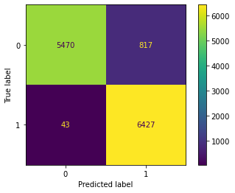
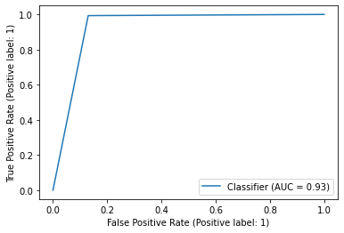

BRITISH AIRWAYS
Predicting customer buying behaviour
The dataset was Upsampled and a Decision Tree Classifier was used to train.
The accuracy is 93%
RoC AUC Curve
Confusion Matrix
The correlation matrix suggests that none of the columns are related.
Classification Report
 | Precision | Recall | F1-score
0 | 0.99 | 0.87 | 0.93
1 | 0.89 | 0.99 | 0.94
Cross Validation (5) scores :
0.910, 0.916, 0.913, 0.910, 0.913

